Slide 1
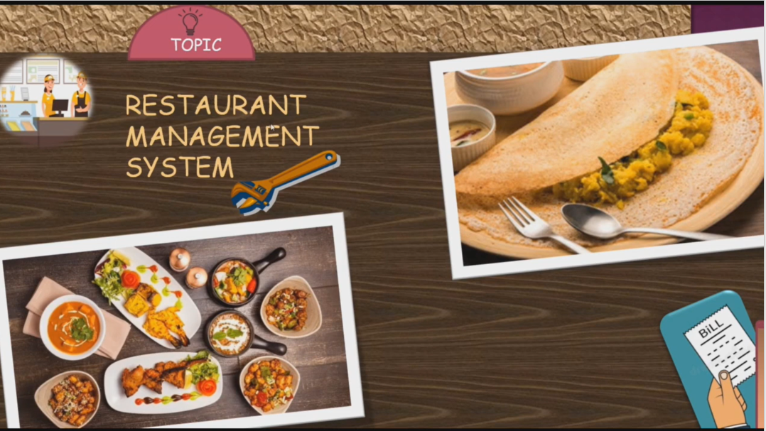
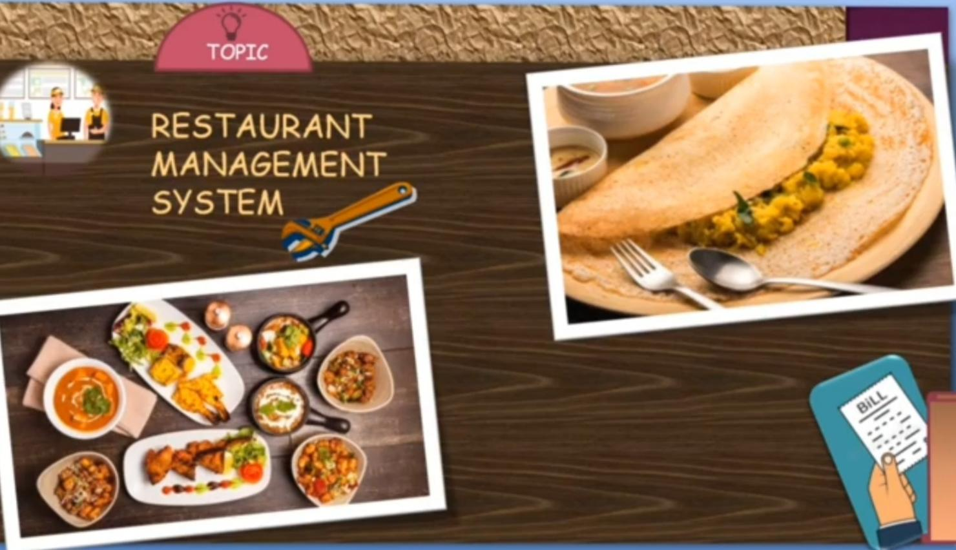

Slide 2
INTRODUCTION
The Project “Restauranrt Management System”helps the restaurant manager to manage the restaurant more effectively and efficiently by computerizing meal ordering ,billing and inventory control.
The best way to optimize these activities is growing the bussiness online as well.Today’s generation encourages high-tech services especially over the internet.

Slide 3
FLOW CHART
ABSTRACT VIEW:
START
HOME PAGE
GALLERY
ORDER
REVIEW
RATING
LOGOUT

Slide 4
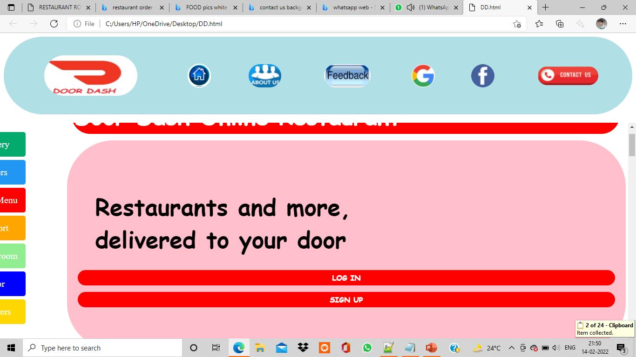
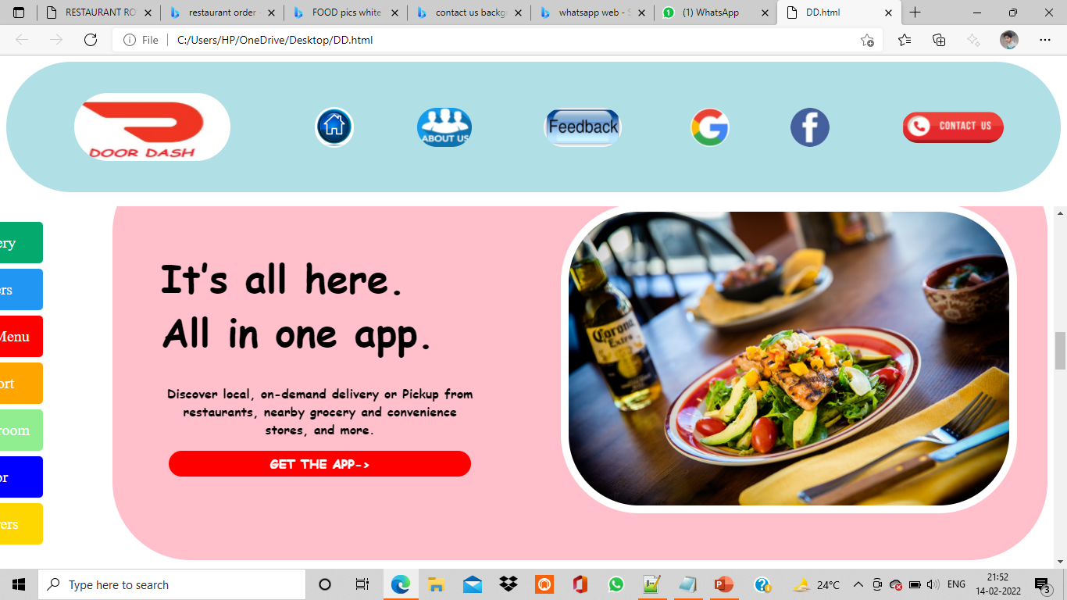
My web page

Slide 5
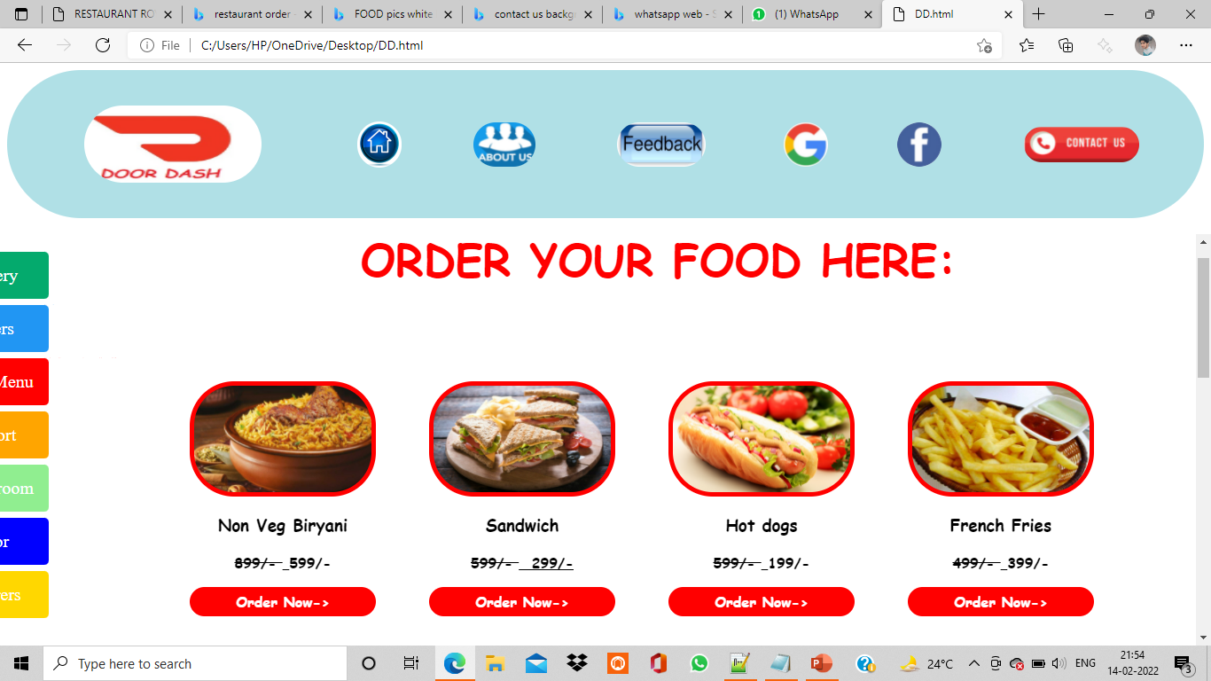
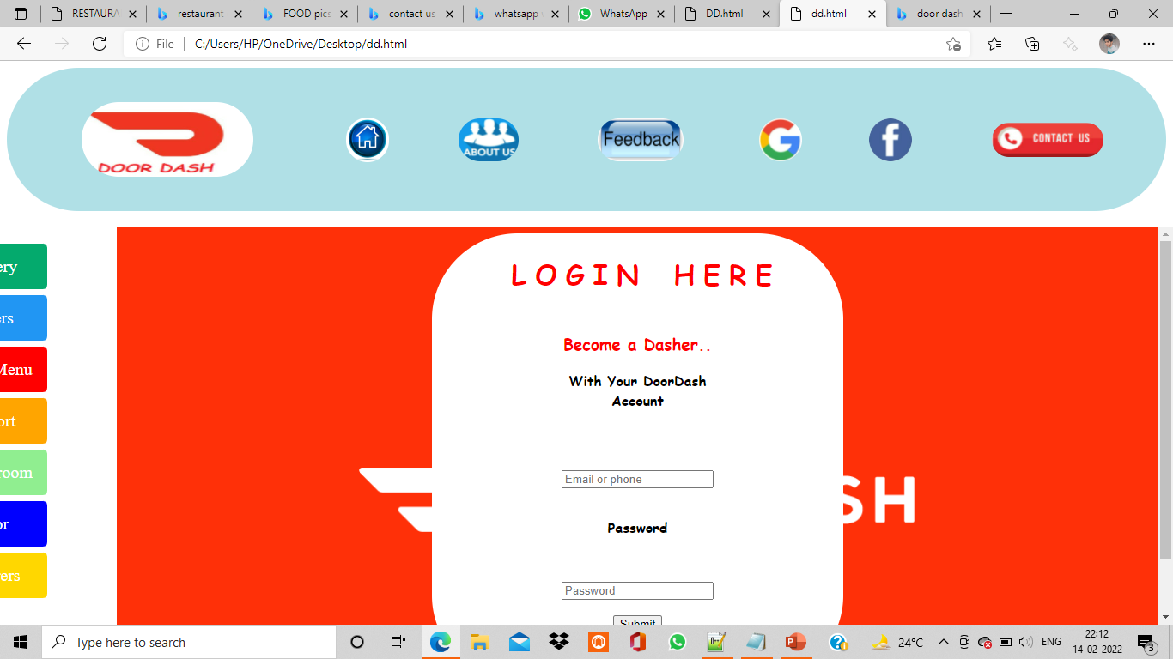
Menu and Login Form

Slide 6
CONCLUSION
So atlast the main theme for my application(or)project is setting up an online ordering system which sets up a restaurant for efficiency,Growth and a steady increase in revenue.
If you were new to this Online Ordering,This is the good way to encourage customers to order on your website.

